Slide 1
Software Testing Methodologies
Prashant Joshi

Slide 2
Module 3: Agenda
Module 3: Specification Based Testing – (1/2)
Topic 3.1
Specification Based Testing – Overview
Topic 3.2
Equivalence Class
Topic 3.3
Boundary Value Analysis
Topic 3.4
Examples & Case Study

Slide 3
Topic 3.1: Specification Based Testing – Overview

Slide 4
The Concept
A black box test technique
Based on specifications
Independent of implementation
Focus
Functional testing
Behaviour
Input & corresponding output
x
P
(Square
of number)
x²
Implementation may be,
Multiplication (x*x)
successive addition (x+x… x times)

Slide 5
Approaches & “View”
Purpose is to uncover defects
Demonstrate the system works (Treat this as a by-product!)
Validate that it functions per specifications
Works as specified – always!

Slide 6
Perspectives
Customer/Client
Alpha/Beta User
End User/Consumer
Development Engineer
Architect
Product Manager
Maintenance Engineer
…

Slide 7
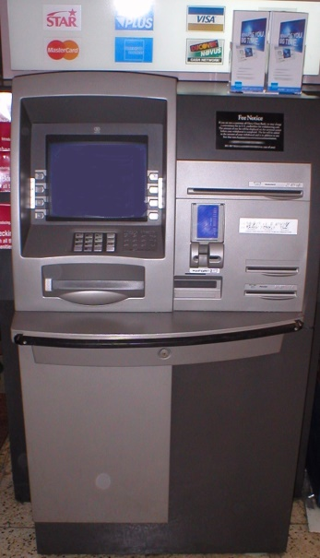
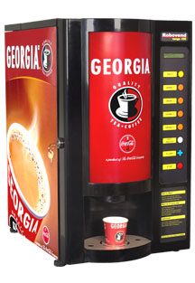
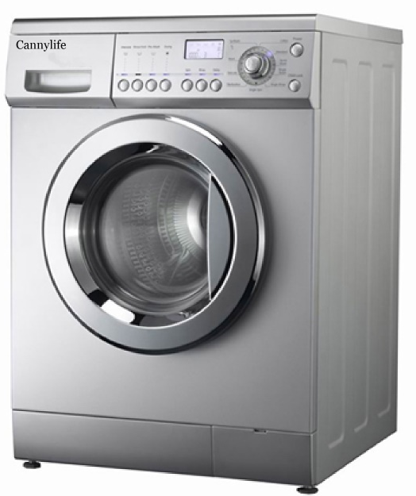
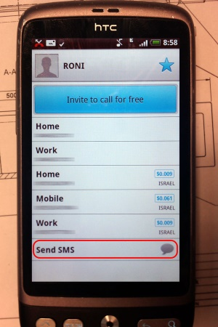
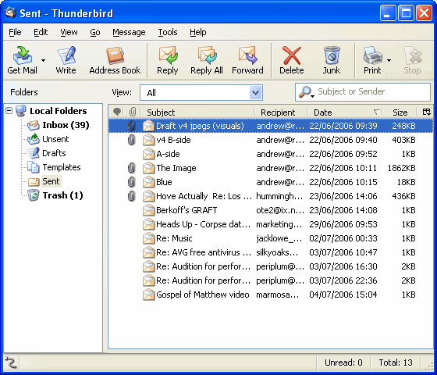
Examples
Automated Teller Machine
Tea/Coffee Vending Machine
Washing Machine
Contacts – Mobile Phone Application
Messaging – Mobile Phone Application
Email – Webmail/App/Client
…

Slide 8
Software Testing Methodologies
Prashant Joshi

Slide 9
Topic 3.2: Equivalence Class Partitioning

Slide 10
Examples
Problem 1
Design Test Cases for a Software Program that takes in an input of up to 1000 numbers, finds the maximum and output is the max number
Problem 2
Design and Discuss test cases for a function returns the max of 3 numbers. The numbers must be integer, else it returns an error

Slide 11
Equivalence Class
What is an equivalence class?
How is it useful to us as test designers?

Slide 12
Equivalence Class
EC forms a partition of a set (input domain), where partition refers to a collection of mutually disjoint subsets (subdomains) when the union is an entire set
Two important implications
The fact that the entire set is represented provides a form of completeness
The disjointedness ensures a form of non-redundancy

Slide 13
Equivalence Class
Reduces the potential redundancy
The subsets are determined by an Equivalence relation, the elements have something in common
Idea of EC is to identify (at least) one test case from each EC
Choice of EC is a challenge!

Slide 14
EC Types
Equivalence Classes (EC) - Types
Weak Normal (WN)
Strong Normal (SN)
Weak Robust (WR)
Strong Robust (SR)
Types which ensure that we choose the “correct” set of test cases from the ECs we come up with

Slide 15
EC - Example
A program takes 2 inputs x1 and x2
a <= x1 <= d
e <= x2 <= g
We have the intervals
[a, b), [b, c), [c, d] ← x1
[e, f), [f, g] ← x2
[ → closed interval endpoint
( → open interval endpoint
< > → Ordered pair
( ) → Unordered pair

Slide 16
EC – Weak Normal
One variable from each EC
A systematic way of deriving the EC
Same number of weak EC test cases as classes in the partition with the largest number of subsets
Based on a single fault assumption
Testing valid subdomains
Assumption
Input variables are independent
One dimensional valid subdomains
Selects tests from one dimensional (one variable) subdomains

Slide 17
EC – Weak Normal
g
f
e
a
b
c
d

Slide 18
EC – Strong Normal
Based on a multiple fault assumption
We derive test cases out of the Cartesian product of equivalence classes
Notion of “completeness”
Testing valid subdomains
Assumption
Input variables are related
Multidimensional subdomains. (Example)
Test selection: Select at least one test from each of the multidimensional sub domain

Slide 19
EC – Strong Normal
g
f
e
a
b
c
d

Slide 20
EC – Weak Robust
Weak Robust is counter-intuitive.
Robust comes from the consideration of invalid values
Weak refers to the single fault assumption
A test case should have one invalid value and the remaining values should be valid
One dimensional invalid subdomains

Slide 21
EC – Weak Robust
g
f
e
a
b
c
d

Slide 22
EC – Strong Robust
Robust comes from consideration of invalid values for inputs
Strong refers to the multiple fault assumption

Slide 23
EC – Strong Robust
g
f
e
a
b
c
d

Slide 24
EC - Characteristics
A group forms a EC if
They all test the same thing
If one test case catches a defect, the others probably will too
If one test case doesn’t catch a defect, the others probably won’t either
What makes us consider them as equivalent
They involve the same input variable
They result in similar operations in the program
They affect the same output variable
None force the program to do error handling or all of them do

Slide 25
Recommendations for Identifications of EC
Equivalence class for invalid inputs
Looks for Range in numbers
Look for membership in a group
Analyse responses to lists and menus
Looks for variables that must be equal
Create time-determined equivalence classes
Look for equivalent output events
Look for variable groups that must calculate to a certain value or range
Look for equivalent operating environments
Ref: Testing Computer Software, Kaner, Falk and Nguyen, Chapter 7

Slide 26
Software Testing Methodologies
Prashant Joshi

Slide 27
Topic 3.3: Boundary Value Analysis

Slide 28
Boundary Value Analysis
Boundary Value Analysis focuses on the boundary of the input space to identify test cases
Rationale is, errors tend to occur near the extreme value of the input variable
Examples
Loop counters off by 1
Inputs at the boundary of ranges. 10 < x < 100

Slide 29
Boundary Value Analysis
Idea of BVA is to use input variable values at
Their minimum
Just above the minimum
A nominal value
Just below their maximum
At their maximum

Slide 30
BVA – Explore the types
Example
A program takes 2 inputs x1 and x2
a <= x1 <= b
c <= x2 <= d
We have the intervals
[a, b] ← x1
[c, d] ← x2

Slide 31
BVA
BVA test cases for a function of two variables – single fault assumption
d
c
a
b

Slide 32
Generalising BVA
Two ways
Number of input variables
Ranges
Variable generalization
Hold one at the nominal value and let the other variable assume min, min+, nom, max- and max. i.e. 4n+1 test cases

Slide 33
BVA Limitations
BVA works well when the program to be tested is a function of several independent variables that represent bounded physical quantities
No consideration to the functionality or semantic meaning of variables

Slide 34
BVA – Worst Case Analysis
d
c
a
b

Slide 35
BVA – Robust Worst Case
d
c
a
b

Slide 36
BVA – Special Value Testing
Practiced form of functional testing
Most intuitive and least uniform
Use of Test Engineer’s domain knowledge
Gut feel
Ad hoc testing

Slide 37
Edge Testing
ISTQB Advanced Level Syllabus (ISTQB, 2012) describes a hybrid of BVA and EC
Edge Testing
Faults near the boundaries of the classes
Normal & Robust for Edge Testing
g
f
e
a
b
c
d

Slide 38
Software Testing Methodologies
Prashant Joshi

Slide 39
Topic 3.4: Examples & Case Study

Slide 40
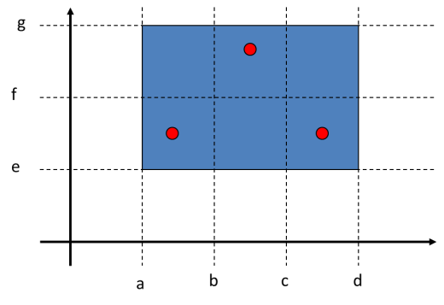

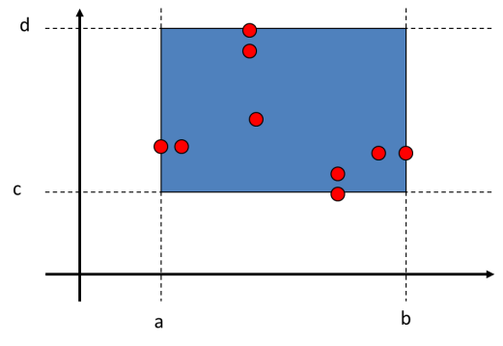
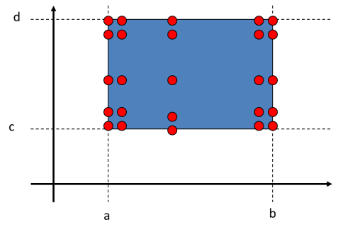


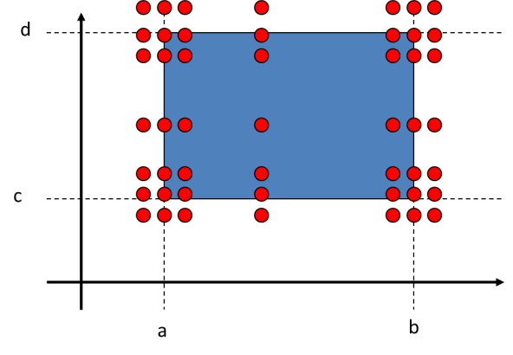
EC & BVA
BVA
Weak Normal
Weak Robust
Worst Case Analysis
Strong Normal
Strong Robust

Slide 41
Examples
Problem 1
Design Test Cases for a Software Program that takes in an input of up to 1000 numbers, finds the maximum and output is the max number
Problem 2
Design and Discuss test cases for a function returns the max of 3 numbers. The numbers must be integer, else it returns an error

Slide 42
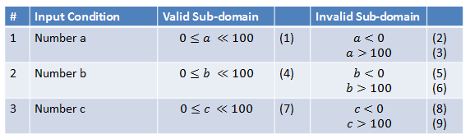
Example – Max of 3 numbers
Choose the subdomains to satisfy for a specific type of EC or BVA
Choose an input to form the test case

Slide 43
Process for Test Case Creation
Create a table with valid and in-valid subdomains
Number the rows
Based on the focus (WN, SN, WR, SR of EC) pick the combination of the rows (valid and in-valid subdomains)
Choose a value and outcome which will form a test case
Repeat any or all steps to arrive at coverage and completeness as required for the problem at hand

Slide 44
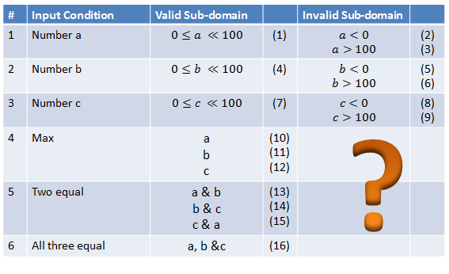
Example – Max of 3 numbers

Slide 45
Examples - discuss
Discuss various test cases and design approaches
What types of faults are anticipated?
Are the requirements sufficient?
Any assumptions made? How were the assumptions made?
It is recommended that code should be written for both to understand the problem better.

Slide 46
The Triangle Example
Problem Statement
A program takes an input of a, b and c, which are three sides of a triangle. Based on the length of the three sides the following output is generated,
Not a Triangle
Equilateral triangle
Isosceles Triangle
Scalene Triangle
Variants (a) Type of triangle (b) Which side is the hypotenuse? (c) Area of the triangle

Slide 47
Examples
Automated Teller Machine
Tea/Coffee Vending Machine
Washing Machine
Contacts – Mobile Phone Application
Messaging – Mobile Phone Application
Email – Webmail/App/Client
…

Slide 48
Software Testing Methodologies
Prashant Joshi

